Slide 1

POF
Performance Optimized Fluids

Slide 2

Problem
Solution
There are millions of particles in a small number of liquids. Simulation control particles by physics-based calculations to obtain fluid behaviours. Simulation having difficulties in calculations dependent on a surplus of particles and time and memory complexity increases indirectly. Visualizing millions of particles on a scene are a tedious job.
The main goal of the project is researching ways of enhancing the performance and efficiency of particle-based fluid simulation.
We aim to achieve these goals by reaching particles faster, storing particles in special structures and applying another visualization method into the POF system.

Slide 3
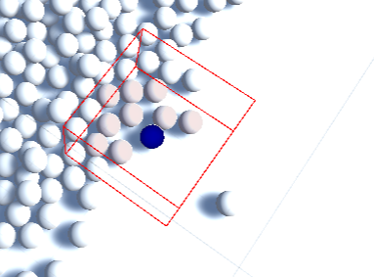
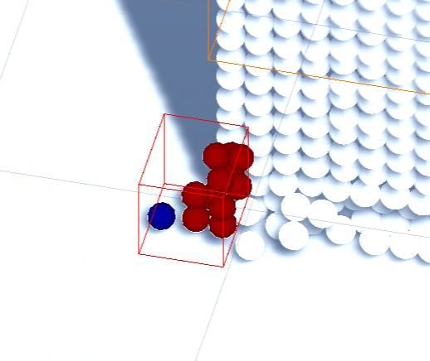
AIM
The POF project based on researching particle-based fluid simulation and improving the performance of the particle-based fluid simulation. Increasing the effectiveness and performance of a particle-based fluid simulation is a primary aim. These goals achieved by implementing algorithms to the POF system such as using special structures to detect and store particles.
Fig 1: Hash System-1
Fig 2: Hash System-2

Slide 4

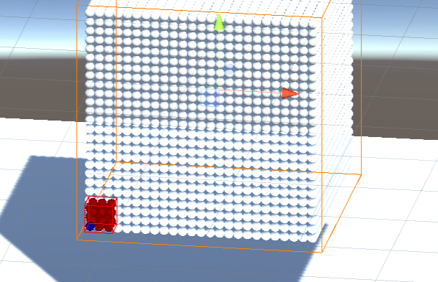
Objectives
The project main objective is making research and implementing the methods in the research papers on particle-based fluid simulations. The implementation of these algorithms consists of two main parts in the POF system: Hash system and surface recognition.
In conclusion, the POF project objective is making research and implement to obtain better performance on finding particles and recognizing surface particles on particle-based fluid simulations.
Fig 3: Perfect Cube

Slide 5
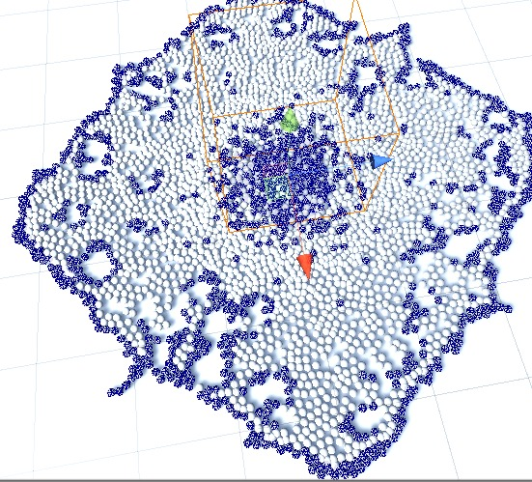
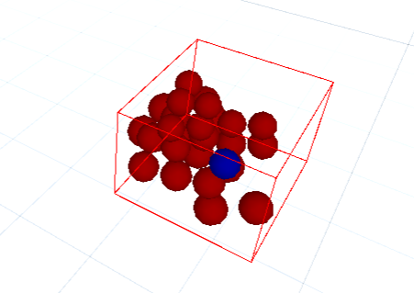
IMPLEMENTATİON
The implementation is of three main parts: First implementation Hasher benefits to the POF by accessing particles easier. The second implementation is surface recognition which is an algorithm used from Akıncı, G. et al. (2012) [1] to draw vertices of surface particles. The third implementation is written by Zhu, Y. et al. [2], offers an alternative way to simulate liquids.
Fig 5: Finding Surface Particles
Fig 4: Tracking Particle within a Cell

Slide 6

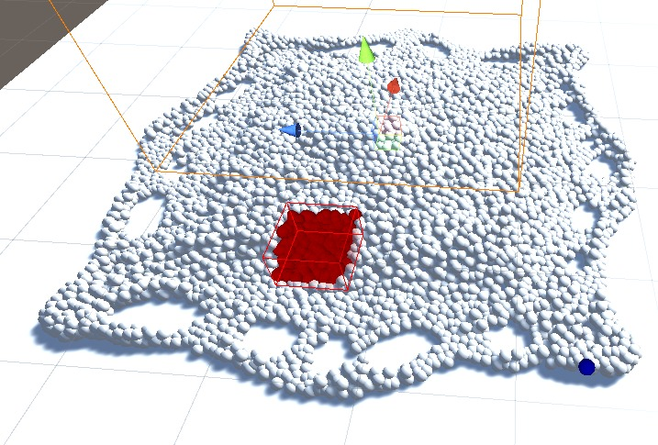
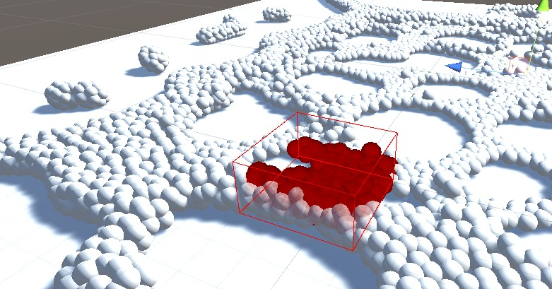
HASH SYSTEM
Hash system is a method to mapping particles in a three-dimensional space converted to the one-dimensional hash table that allows very fast access on particles in the 3-dimensional space domain. Hash system analyses particles position data and finds particles faster through a special function.
Fig 6: Hash System-3
Fig 7: Hash System-4

Slide 7
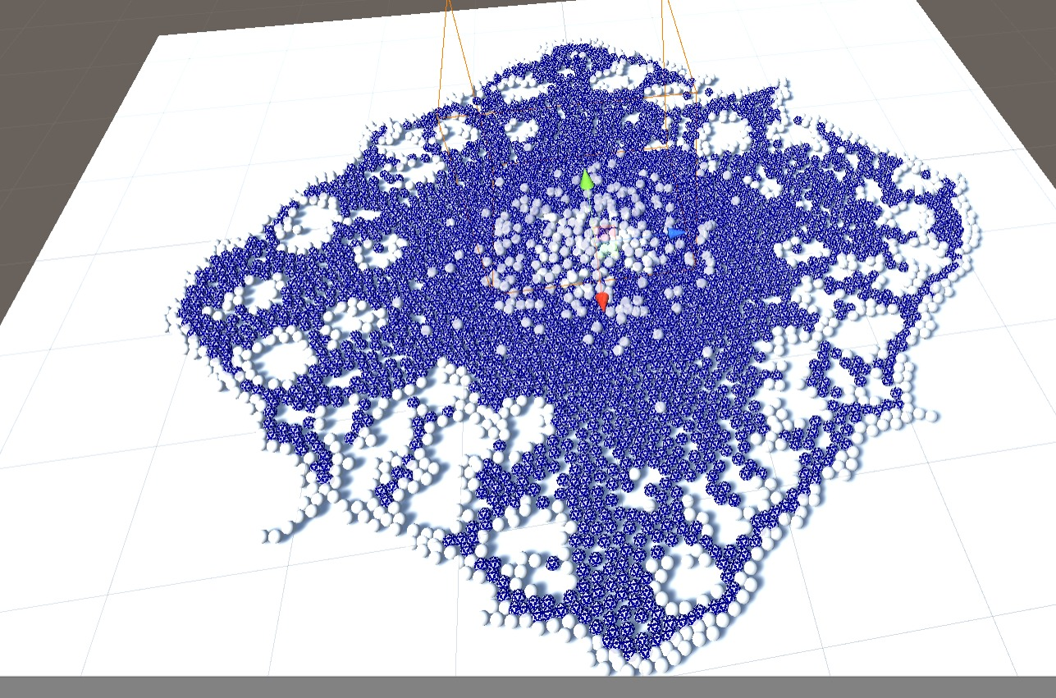


SURFACE RECOGNITION
Surface recognition algorithm detects surface particles and the other necessary data about a particle. Surface recognition finds surface particles by calculating the weight value in a ranged area.
Focusing on finding surface particles is necessary for the drawing part in the POF system. Because of the surface recognition component, the POF system works more efficiently and better performance obtained.
Fig 8: Inner Particles Represented with Blue in Surface Recognition
Mathematical Expressions of Surface Recognition System
$$\overline{x}= \frac{Σ_{j}x_{j}k\left(\left|x−x_{j}\right|∕R\right)}{Σ_{j}k\left(\left|x−x_{j}\right|∕R\right)}$$
1-)
2-)
$φ\left(x\right)=\left|x−\overline{x}\right|−\overline{r}f$

Slide 8
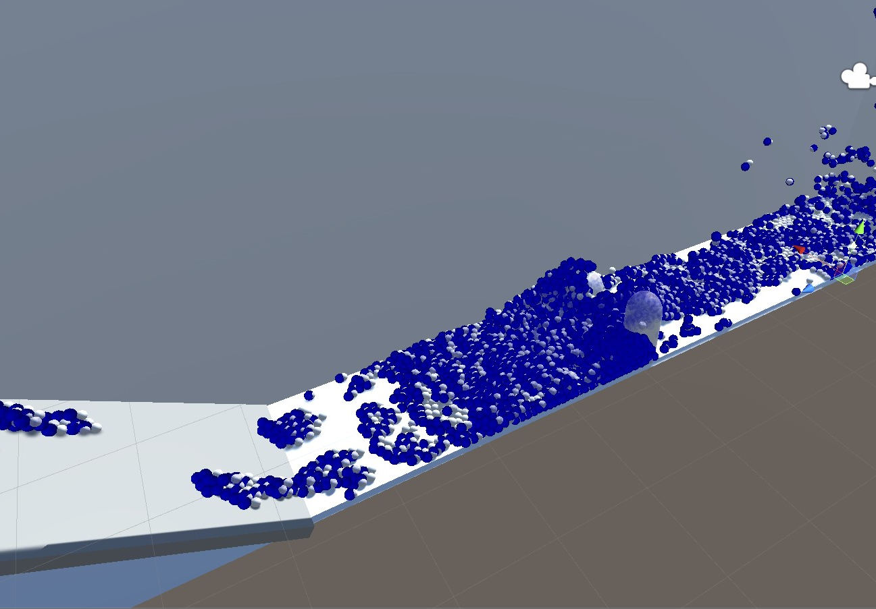
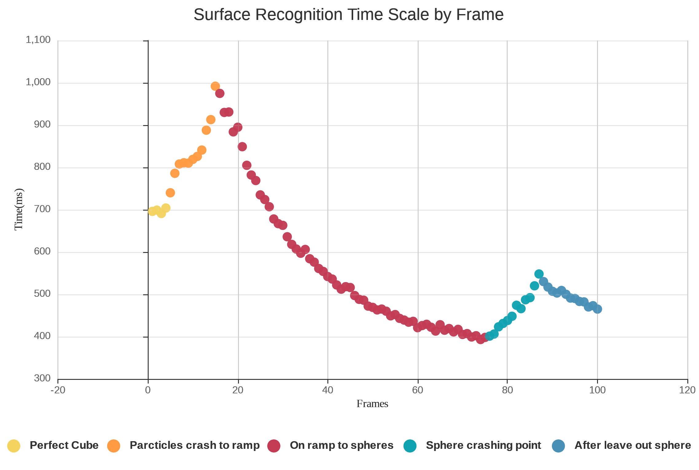
TEST RESULTS 1
Fig 9: Test Scene-1
Fig 10: Surface Recognition Chart as Time-Frame

Slide 9
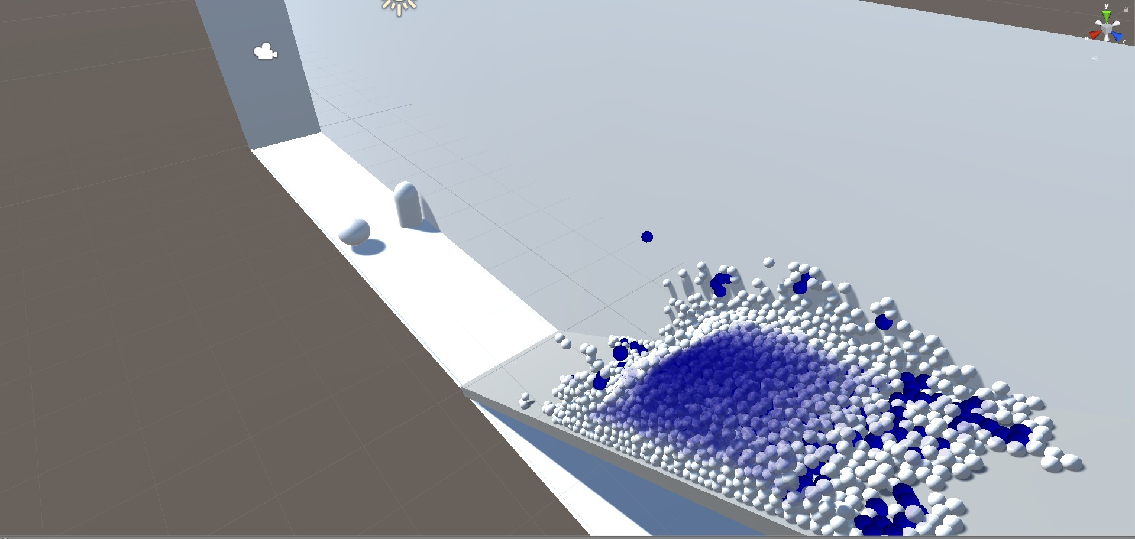
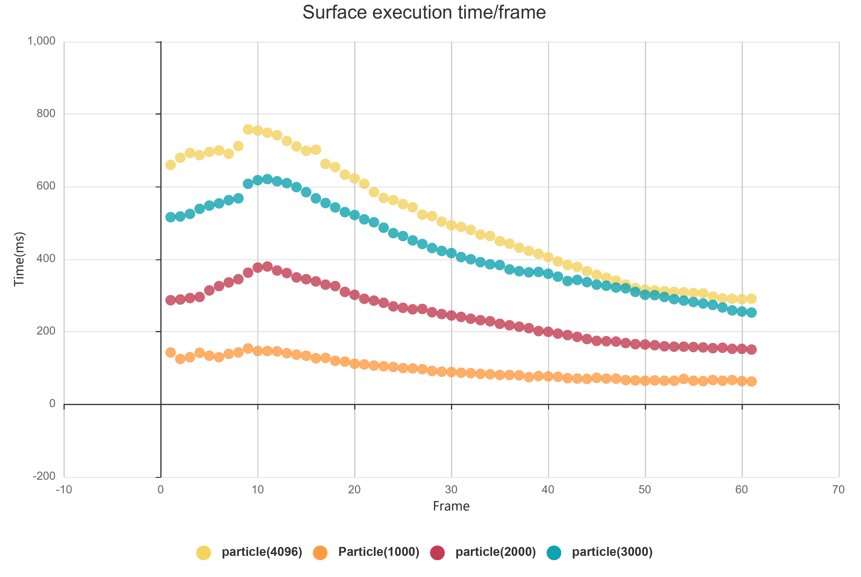
TEST RESULTS 2
Fig 11: Test Scene-2
Fig 12: Surface Execution by Particle Comparison

Slide 10
Conclusion
We implemented various methods such as hash system algorithm and surface particle recognition algorithm. We examined performance efficiency and made tests. We have prepared a test environment to be tested if any other algorithms are tried and requested and an algorithm to compare.
References
1-) [AIA12] Akinci, G., Ihmsen, M., Akinci, N. and Teschner, M. (2012). Parallel Surface Reconstruction for Particle‐Based Fluids. Computer Graphics Forum, 31, 1797-1809.
2-) ZB05] Zhu, Y., & Bridson, R. (2005). Animating sand as a fluid. (New York, NY, USA, 2005) ACM Trans. Graph., 24, 965-972.

Slide 11

THANK YOU FOR LISTENING ☺
Baran Budak 15070001012
Cihanser Çalışkan 16070001020
İsmail Mekan 15070001048

